Slide 1

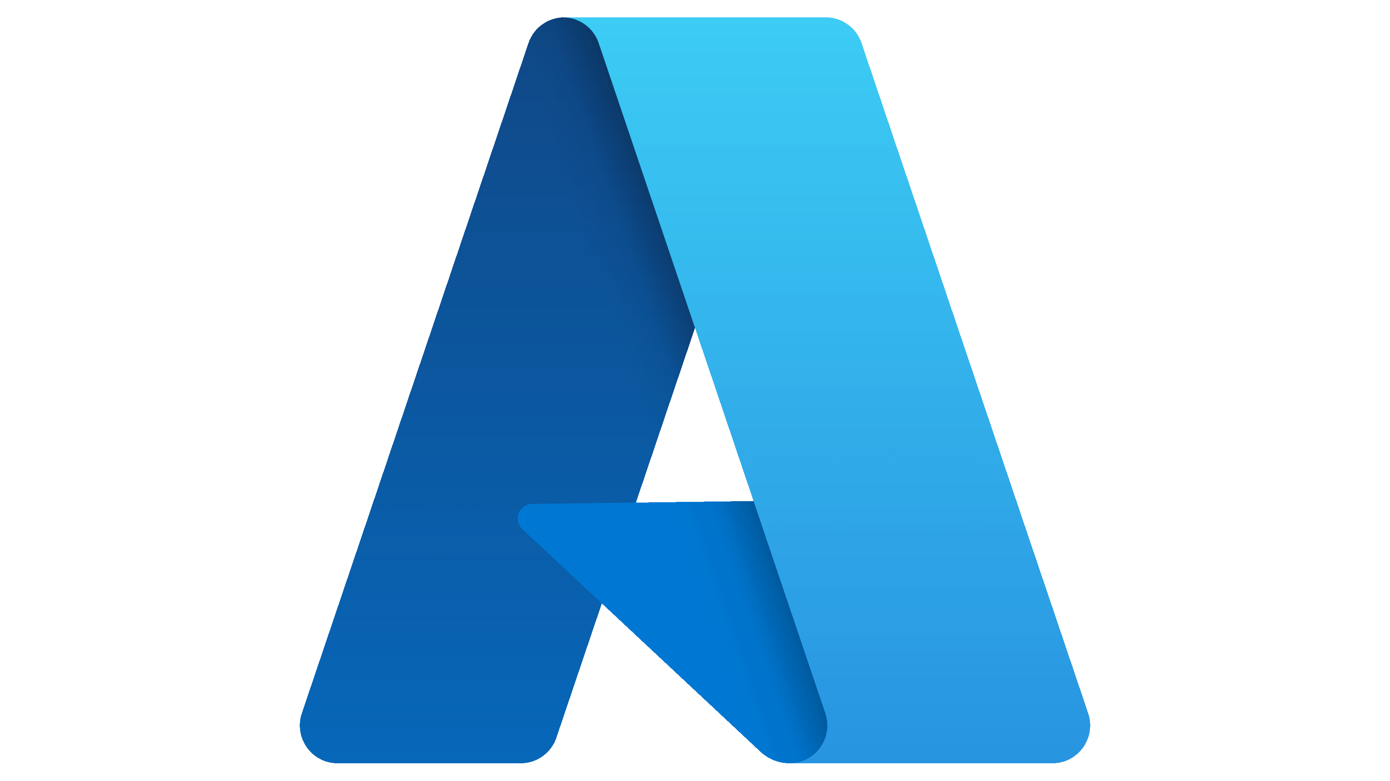
MICROSOFT GGR HACKATHON
GROUP-6

Slide 2
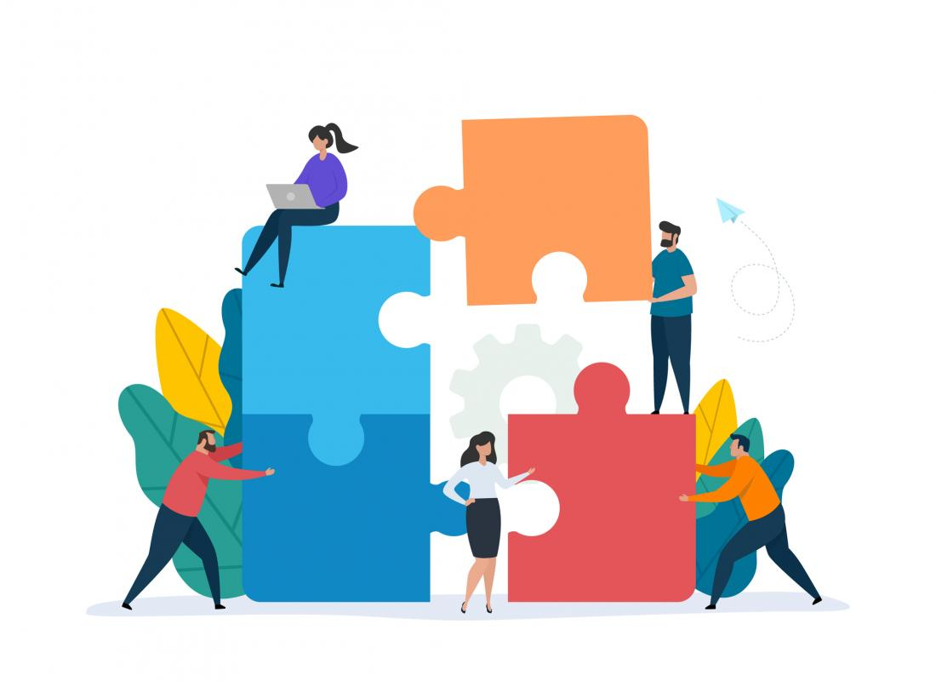
GROUP MEMBERS
PROJECT GUIDE
ALOK SINGH
ARUNA CHAKKIRALA
SHWETA DHENDE (LEAD)
SANIKA THITE (CO-LEAD)
VAISHNAVI UPADHYAY
AVANTIKA SHEDGE
VEENA SANTOSH
BRUNDA BASAVARAJU
LAKSHMI DHARMAVARPU
SHRUTI GUGALE

Slide 3
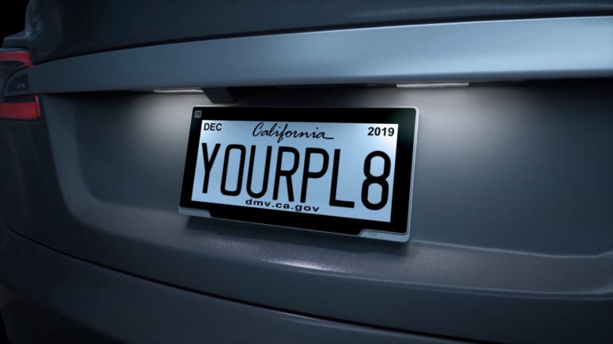
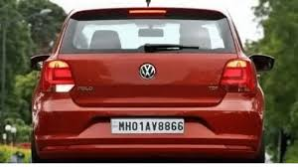
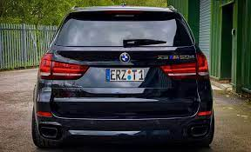
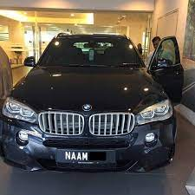
CHALLENGE 1
DETECT VECHICLE’S LICENSE
PLATE
SERVICES USED
Storage account
Blob storage
Custom Vision
LOGIC app
SQL database

Slide 4


CUSTOM VISION
Azure Blob Storage helps you create data lakes for your analytics needs, and provides storage to build powerful cloud-native and mobile apps. Optimize costs with tiered storage for your long-term data, and flexibly scale up for high-performance computing and machine learning workloads.
BLOB STORAGE
Azure Blob Storage helps you create data lakes for your analytics needs, and provides storage to build powerful cloud-native and mobile apps. Optimize costs with tiered storage for your long-term data, and flexibly scale up for high-performance computing and machine learning workloads.

Slide 5
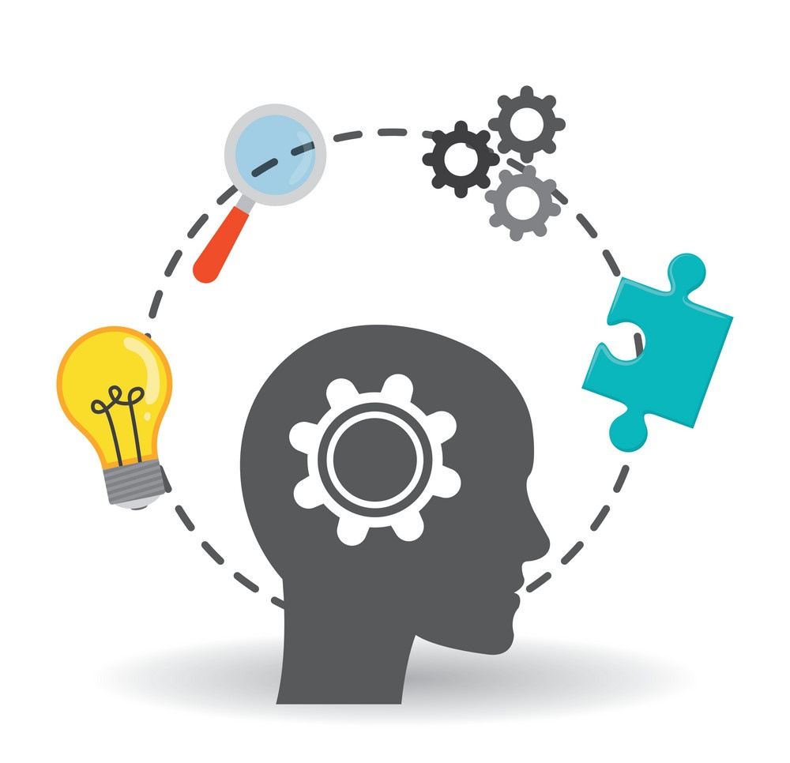
SOLUTION

Slide 6
Develop Custom Vision Model
To develop a custom vision model head over to Custom vision and use a subset of the images that have been downloaded in the prior step This can be done by:
Signing in and create a new project. Choose Name, Description and Resource (using your Azure subscription). Selecting Object Detection as the Project Type and leave the Domain as General.
Upload at least 15 images, selecting the number plate using the editor (give the number plate objects the same e.g. number-plate).
Train a model once all images have been loaded. Once training is complete a set of performance metrics will be displayed. The Quick Training option should be sufficient for this step.
Published the trained model as a REST API. Publishing generates the URL and authentication key for this service. This will be used in the next step.

Slide 7
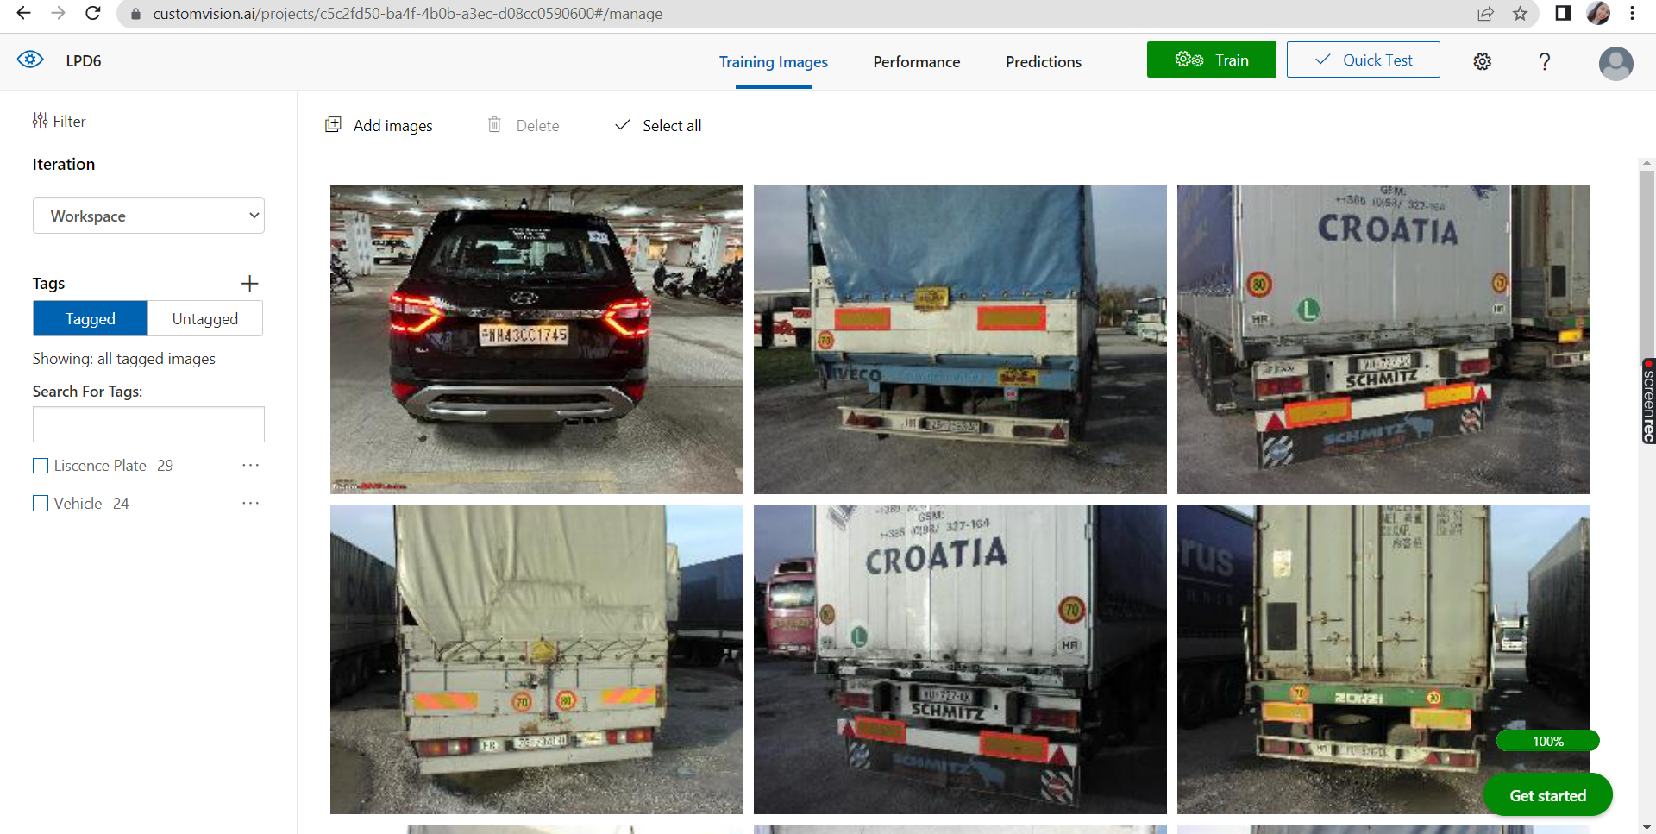
Upload and tag Images

Slide 8
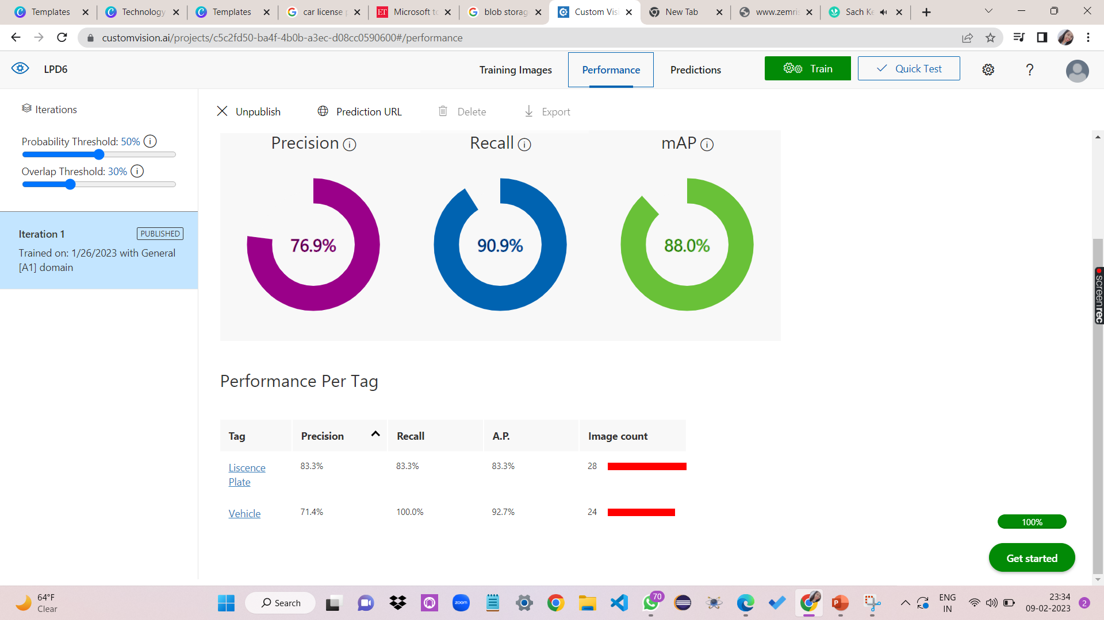
Train

Slide 9
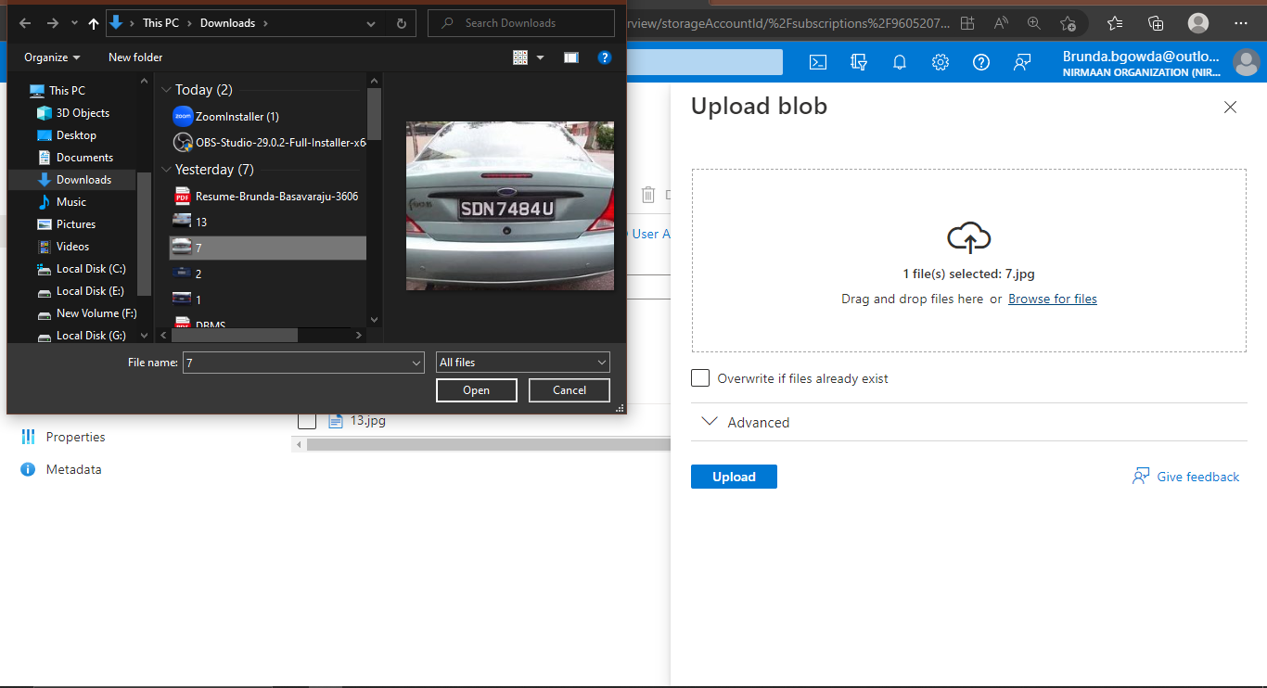
Upload image

Slide 10
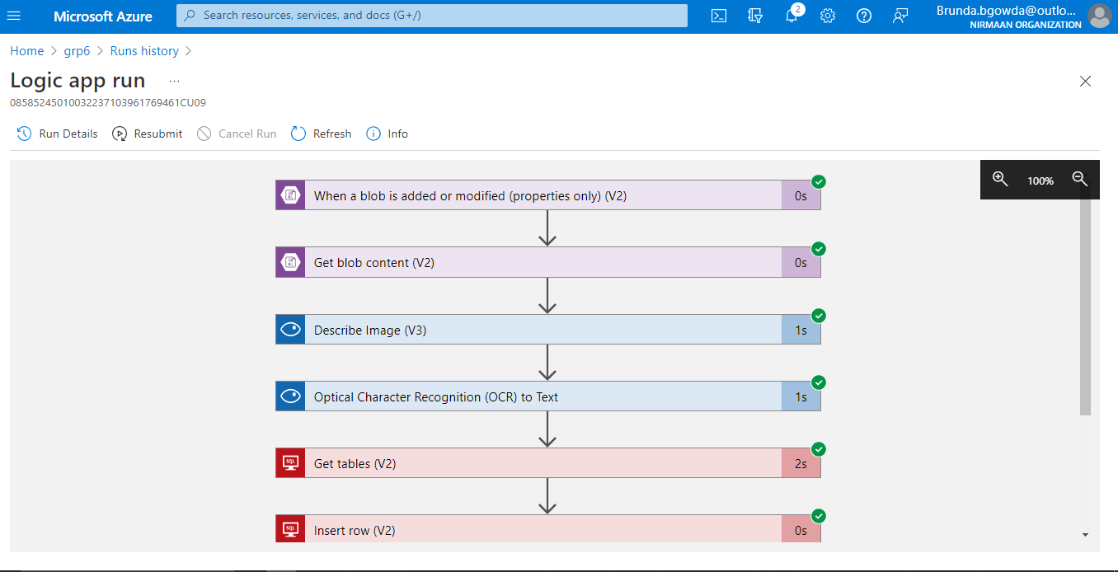
Run the Trigger

Slide 11
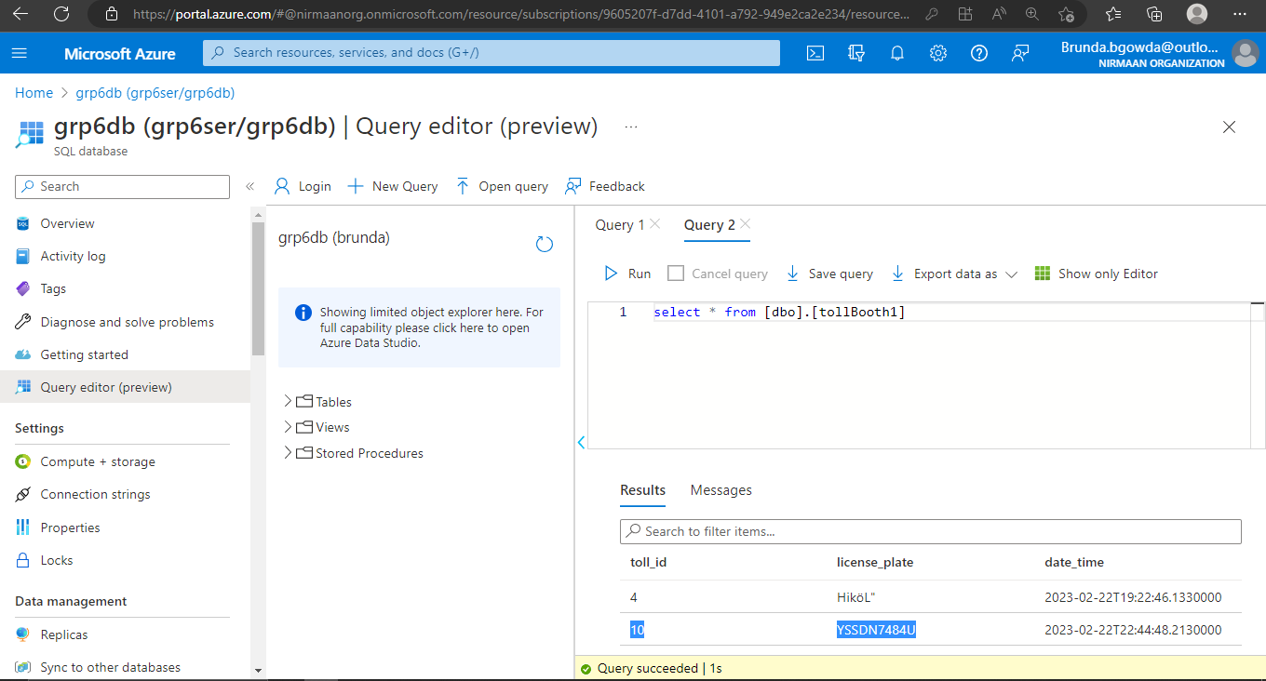
License plate successfully detected

Slide 12
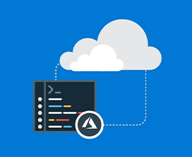
CHALLENGE 2
Classify the health of a fetus as Normal, Suspect or Pathological
using CTG data using Azure Machine Learning.
SERVICES USED
RESOURCE GROUPS
AZURE MACHINE LEARNING STUDIO
WORKSPACE
AUTOMATED ML
JOBS
MODELS
CREATE DEPLOYMENT
SCHEMA
DATASET
12

Slide 13
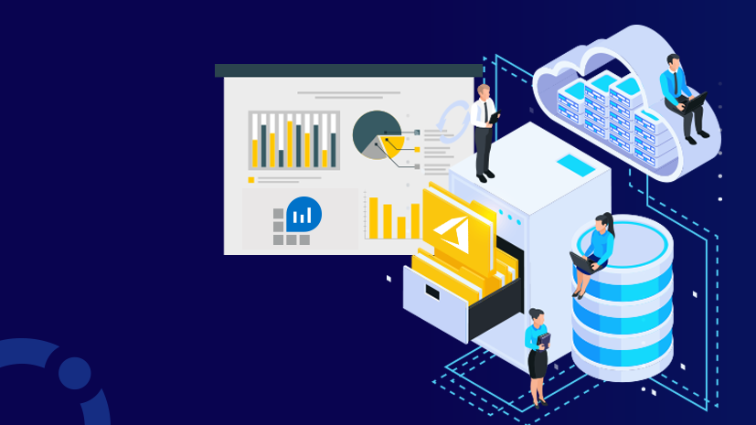
AZURE MACHINE LEARNING Azure Machine Learning is a cloud service for accelerating and managing the machine
learning project lifecycle. Machine learning professionals, data scientists, and engineers
can use it in their day-to-day workflows: Train and deploy models, and manage MLOps. WORKSPACE
The workspace is the top-level resource for Azure Machine Learning, providing a centralized place to work with all the artifacts you create when you use Azure Machine Learning. The workspace keeps a history of
all training runs, including logs, metrics, output, and a snapshot of your scripts. You use this information
to determine which training run produces the best model.
Once you have a model you like, you register it with the workspace. You then use the registered model and
scoring scripts to deploy to an online endpoint as a REST-based HTTP endpoint.
13

Slide 14

MACHINE LEARNING STUDIO
Azure ML Studio is a workspace where you create, build, train the machine learning models. It is a drag and drop tool (Azure Machine Learning Designer) where you can drag the data sets and further process the analysis on that data. It offers both no-code
and low-code options for projects.
AUTOMATED ML Azure Auto ML is a cloud-based service that can be used to automate building machine learning pipelines for
classification, regression and forecasting tasks. Its goal is not only to tune hyper-parameters of a given model,
but also to identify which model to use and how to pre-process the input dataset.
14

Slide 15

PROBLEM AND SOLUTION
PROBLEM AND SOLUTION
15

Slide 16
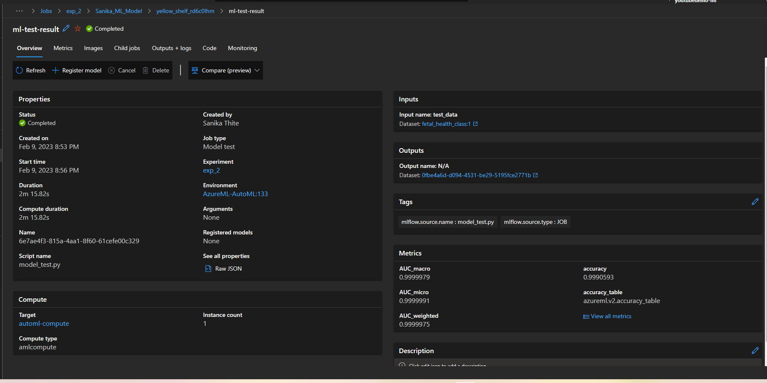
MACHINE LEARNING MODEL TECHNIQUE USED:CLASSIFICATION
16

Slide 17
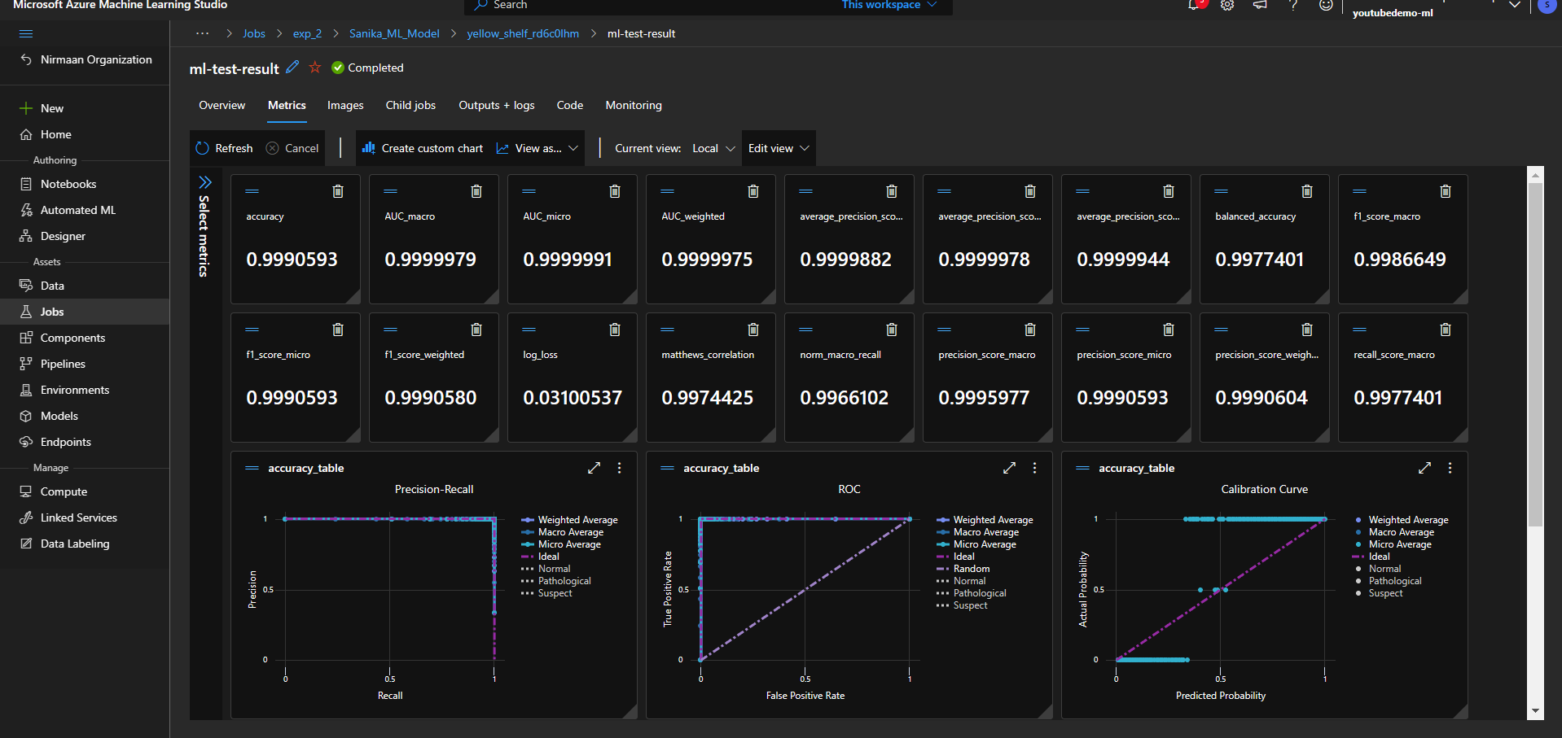
OUTPUT

Slide 18


